Slide 1
Digital Portfolio
STUDENT NAME: BARATH T
REGISTER NO AND NMID: 1E3ACFC0AB4B17E8822421C8AAE48A90
DEPARTMENT: BSc Computer Science
COLLEGE : Vel Tech Ranga Sanku Arts College/ University of Madras

Slide 2
PROJECT TITLE
Digital Portfolio ➤ Name: Barath T ➤ BSc Computer Science, 2nd Year ➤ Key Skills: Java, Web Development, Creative Design ➤ Projects: Web apps, Wallpapers, Logos ➤ Contact: [Email] | [LinkedIn] | [GitHub]

Slide 3


AGENDA
Problem Statement
Project Overview
End Users
Tools and Technologies
Portfolio design and Layout
Features and Functionality
Results and Screenshots
Conclusion
Github Link
3/21/2024 Annual Review

Slide 4

PROBLEM STATEMENT
➤ In today's digital era, traditional resumes are not enough to<effectively showcase skills and projects.
➤ Many students and professionals lack a structured online presence to highlight their work and achievements.
➤ A digital portfolio offers an interactive and accessible solution to present skills, experiences, and accomplishments in a modern, engaging way.

Slide 5

PROJECT OVERVIEW
➤ Brief summary: This project is a digital portfolio to professionally present my background, skills, and creative work.
➤ Contains key sections: About Me, Projects, Skills, and Contact for easy navigation.
➤ Main idea: Showcase personal achievements, highlight technical expertise, and display completed projects in an organized manner

Slide 6

WHO ARE THE END USERS?
Students: Showcase academic projects, assignments, and build resumes for further studies.
Job Seekers: Share skills, experience, and portfolio with recruiters and employers.
Freelancers: Present work samples and completed projects to attract potential clients.
Professionals: Highlight career achievements, expertise, and ongoing development.

Slide 7

TOOLS AND TECHNIQUES
o HTML: Builds the main structure of all portfolio pages and sections.
o CSS: Styles the portfolio with colors, layouts, and makes it responsive for all device sizes.
o JavaScript: Adds interactivity-navigation menu, animations, and form validation.
o Code Editor: Developed using VS Code for efficient coding.
o Hosting: Published online using GitHub Pages for easy sharing and access.

Slide 8
POTFOLIO DESIGN AND LAYOUT
Organized sections :
➤ Home/About Me, Projects, Skills, Contact
➤ Consistent color scheme and clean typography throughout the portfolio
➤ Easy navigation bar for smooth movement between sections
➤ Visual elements like icons and images for better engagement
➤ Fully responsive layout optimized for both mobile and desktop devices
8

Slide 9
FEATURES AND FUNCTIONALITY
➤ Navigation bar with smooth scrolling for easy access to all sections.
➤ Project showcase including images and detailed descriptions for each project.
➤ Interactive elements such as hover effects and animations to enhance user engagement.
➤ Contact form with validation to ensure correct and complete user input.
➤ Responsive design that works seamlessly on desktop, tablet, and mobile devices.

Slide 10
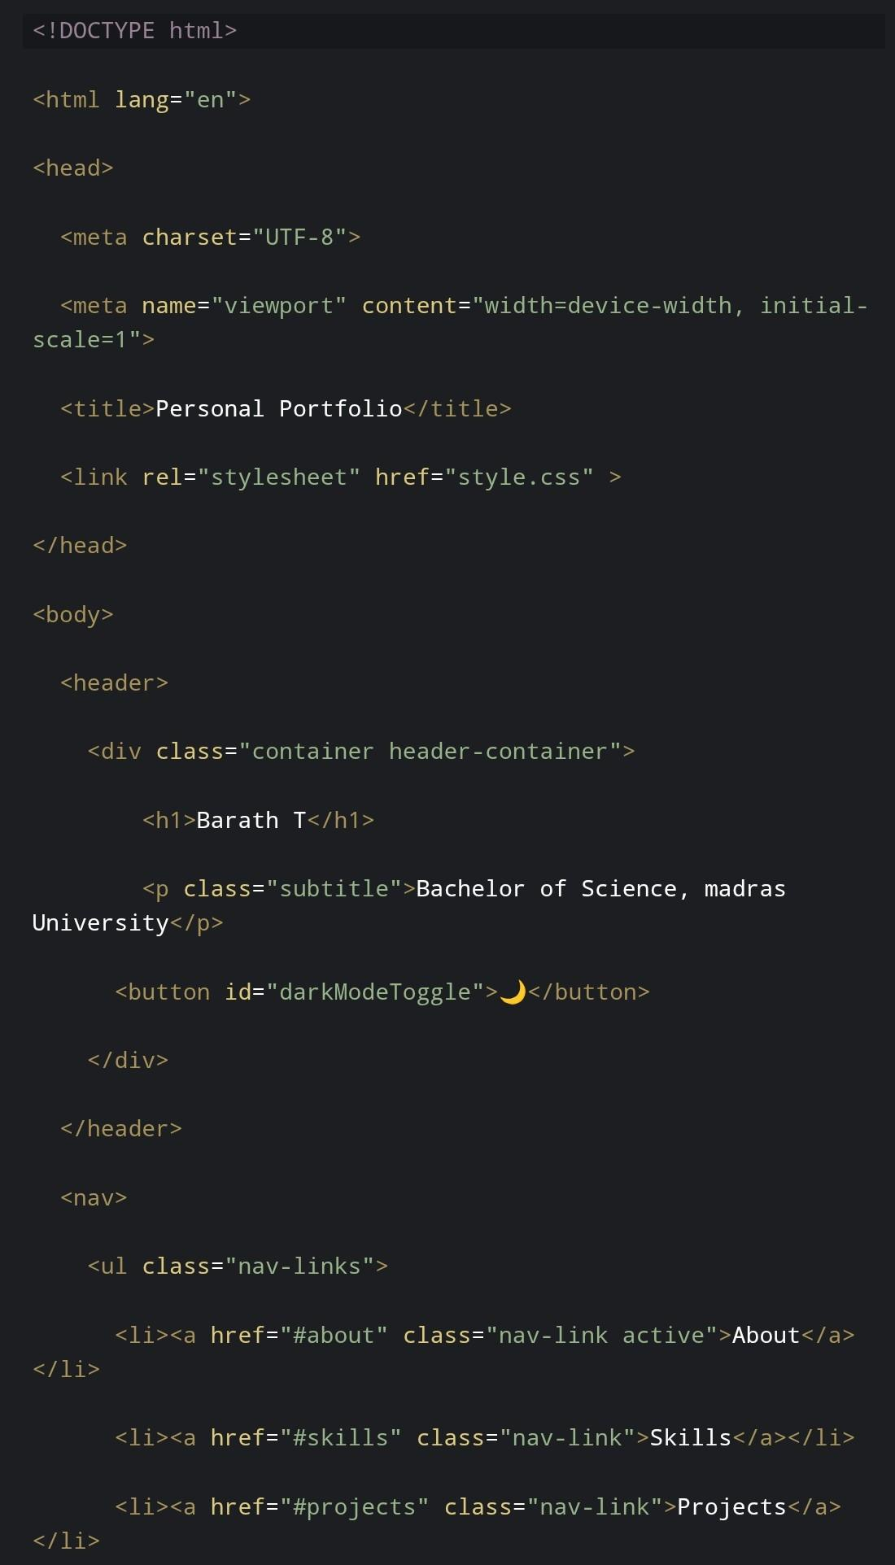
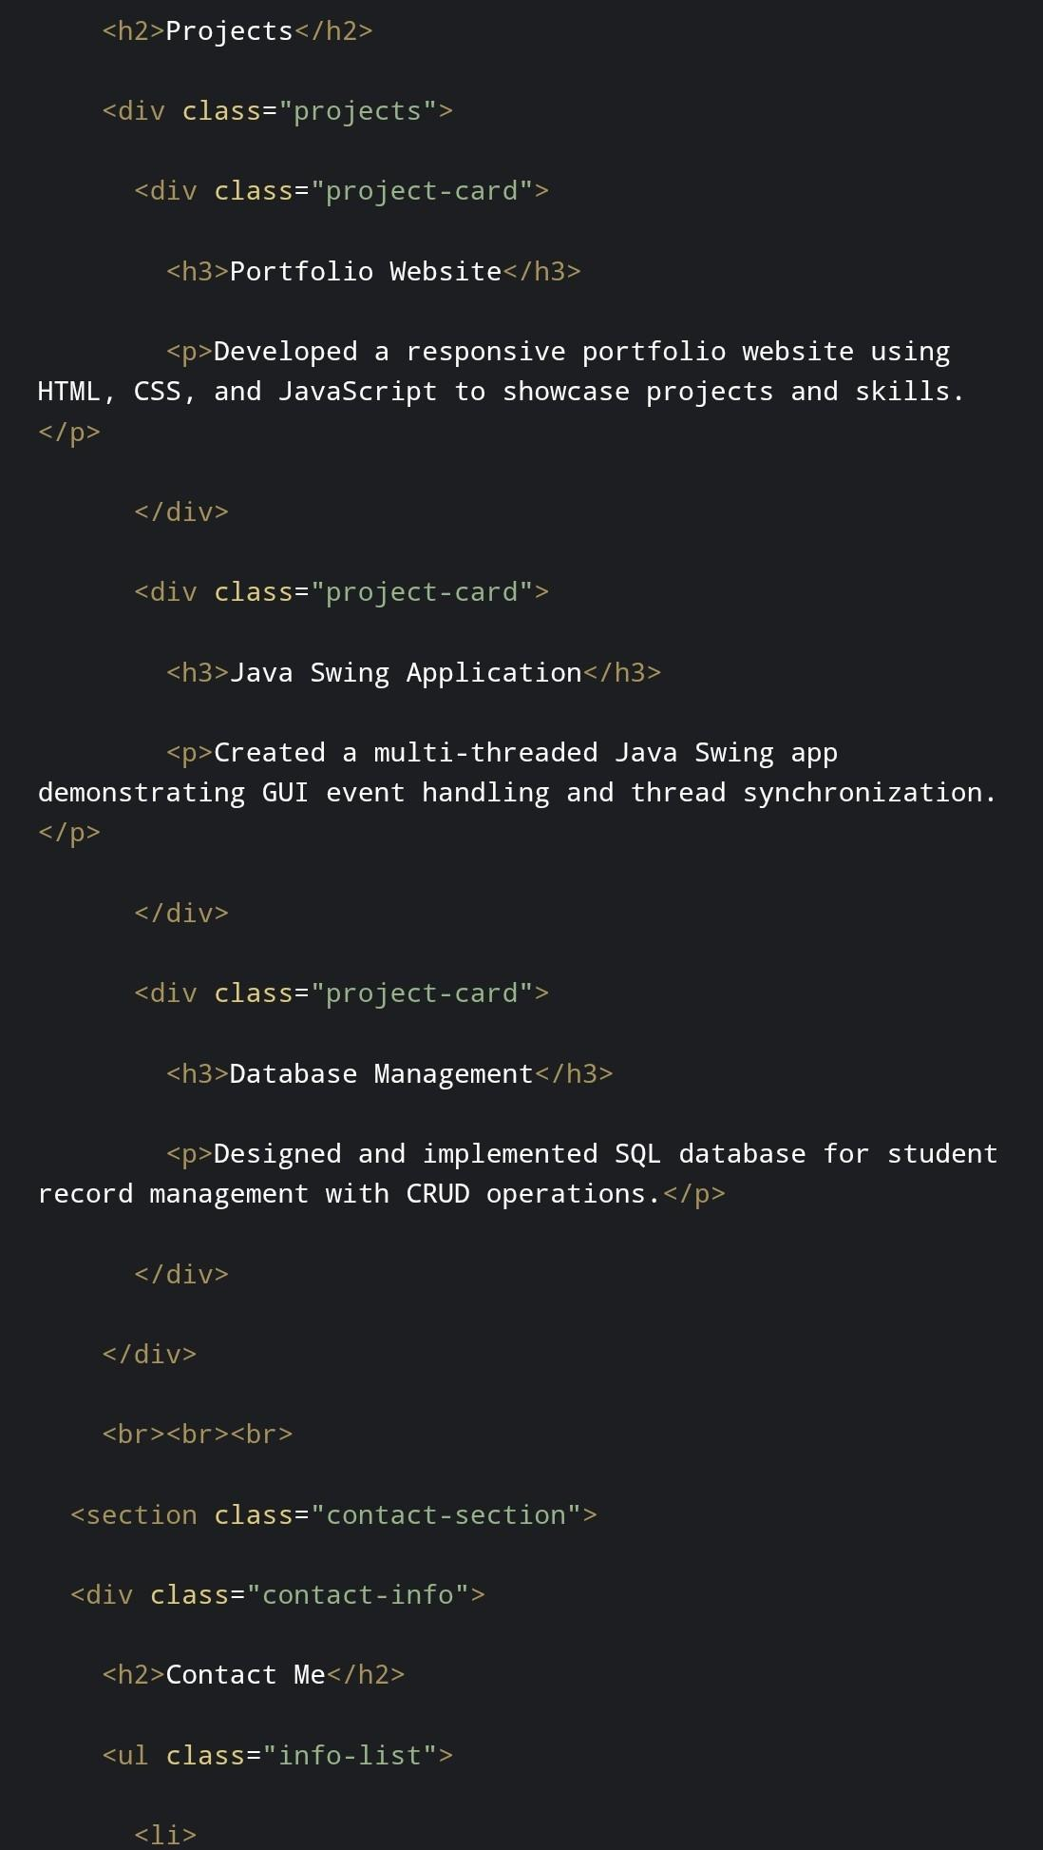

RESULTS AND SCREENSHOTS
HTML :
3/21/2024 Annual Review
10
Notes:
HTML

Slide 11
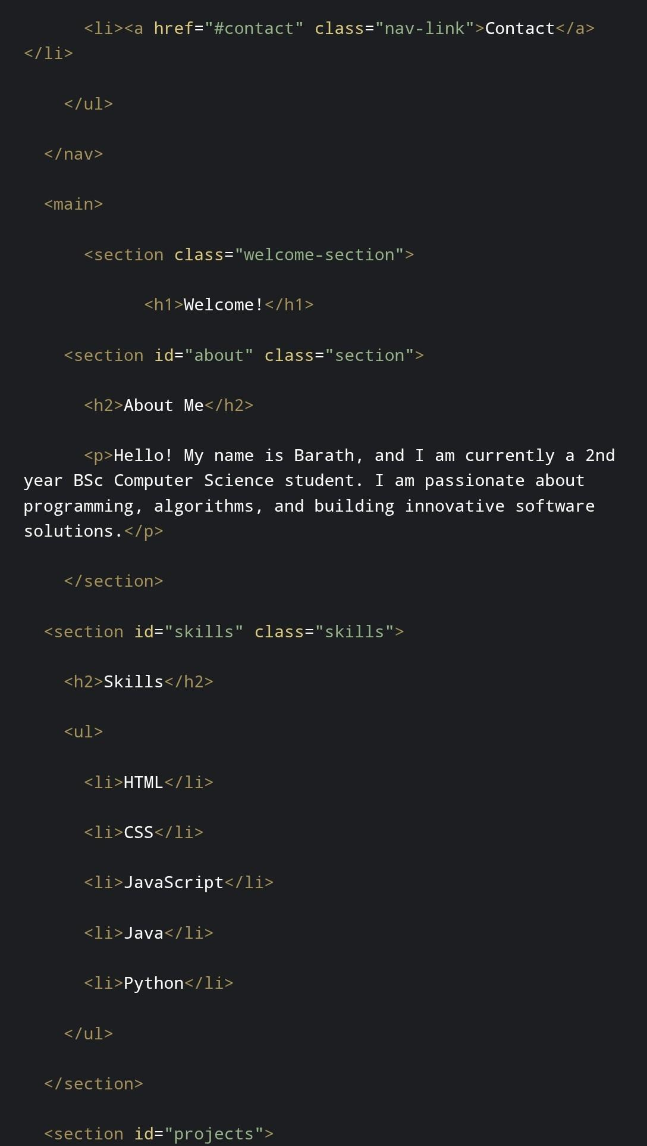
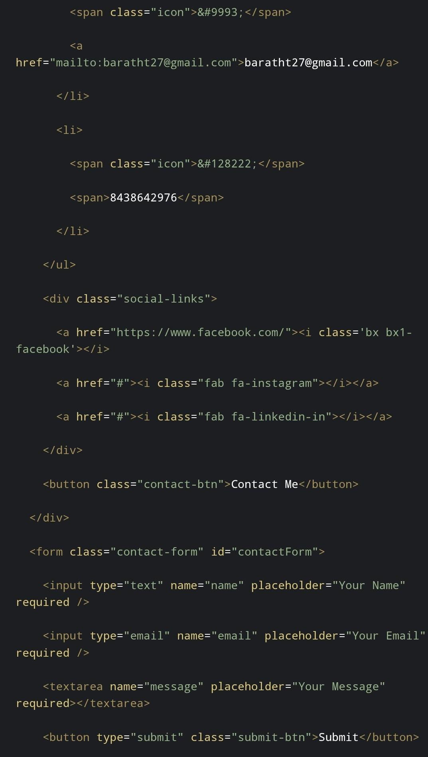
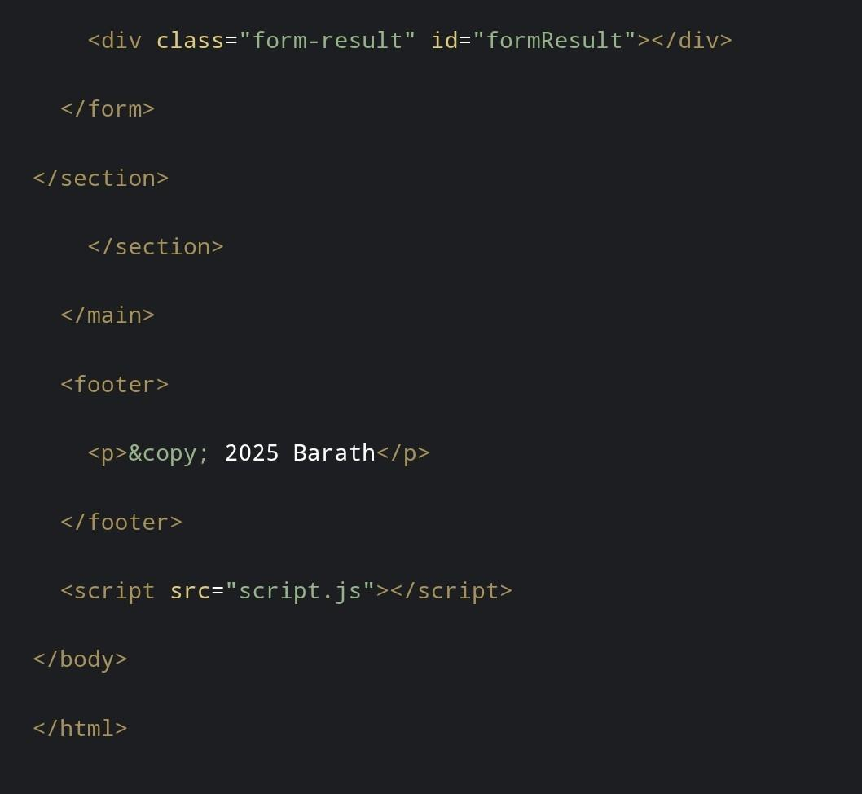
11

Slide 12
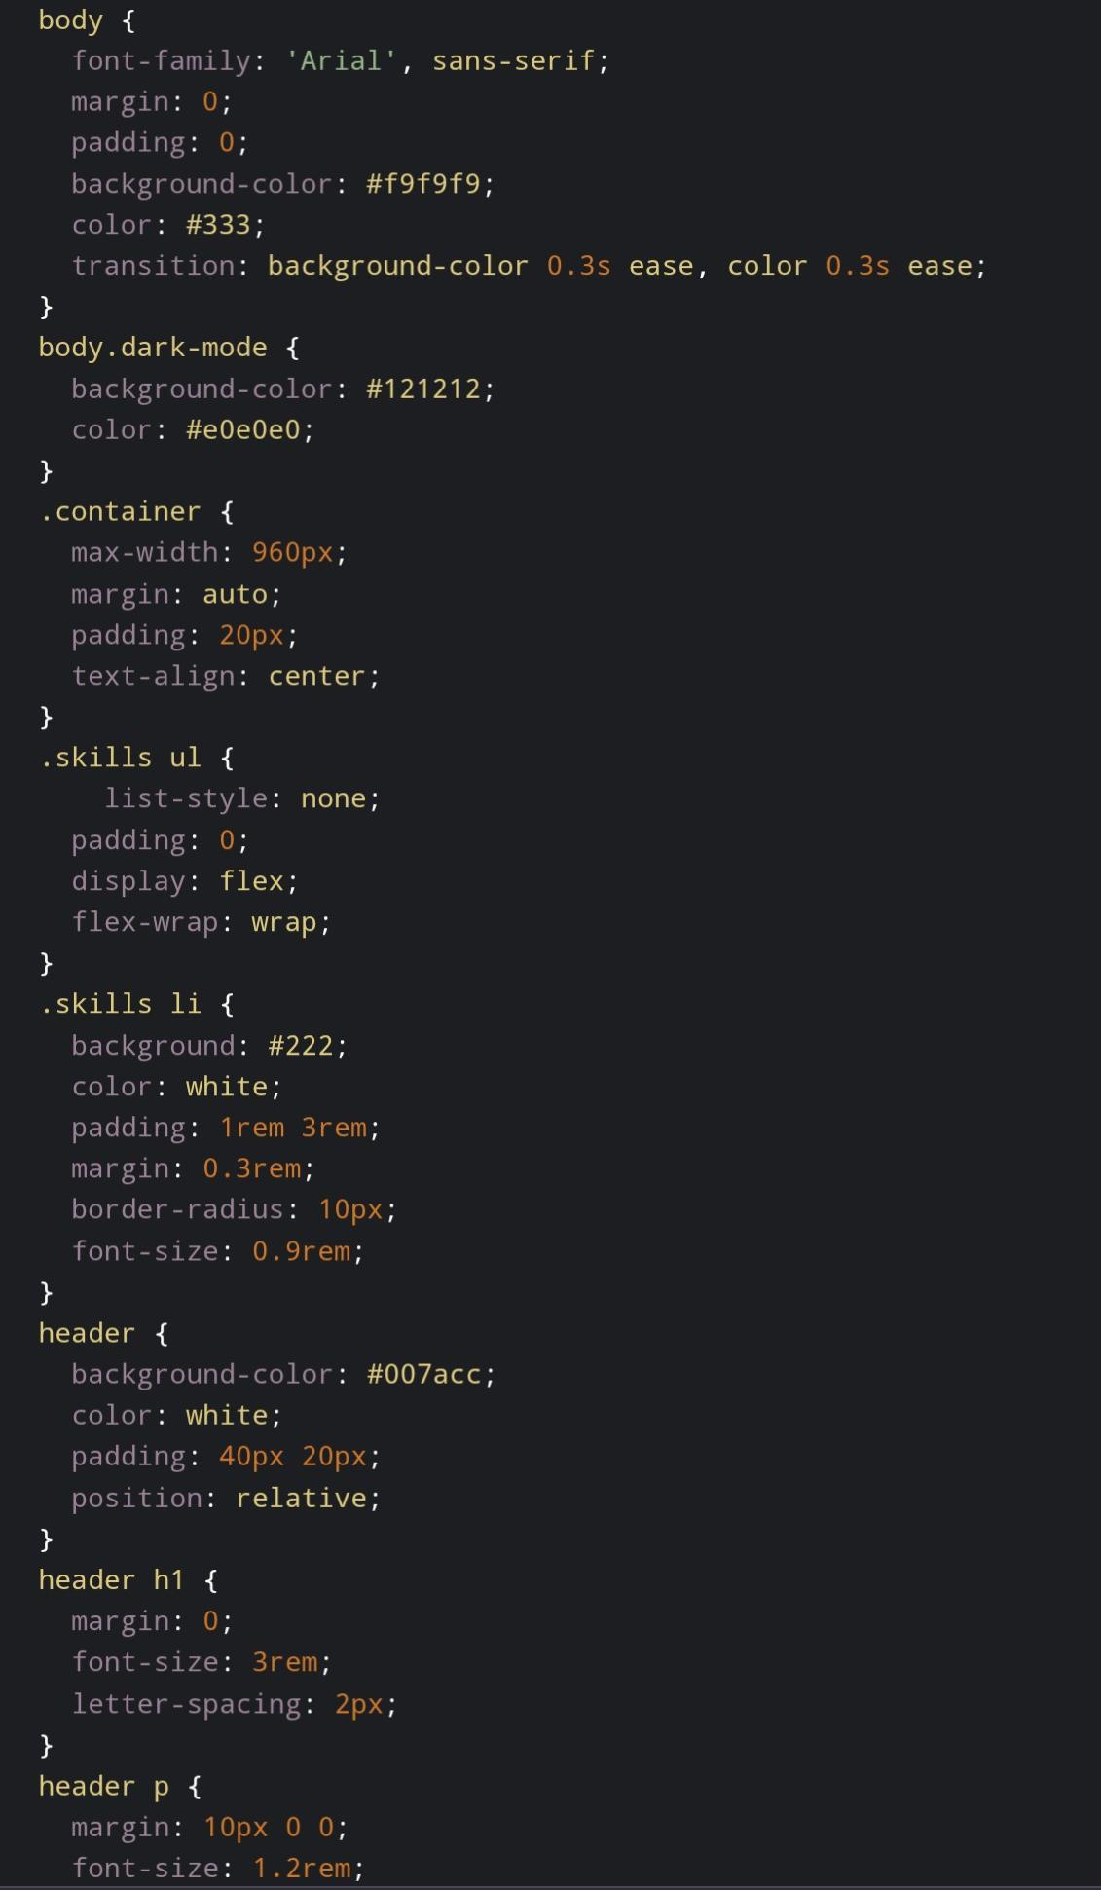
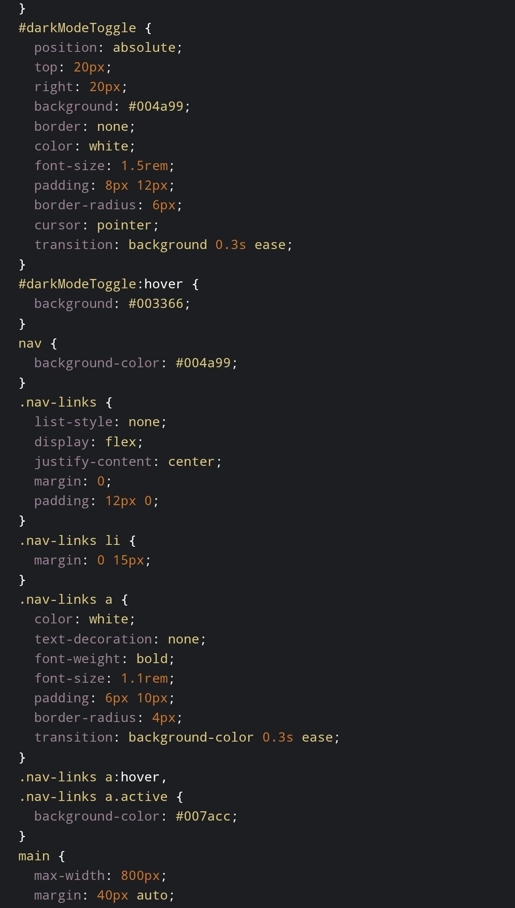
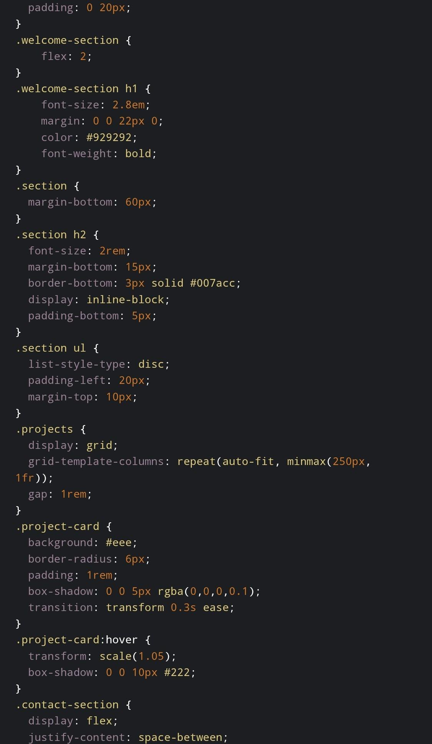
CSS :

Slide 13
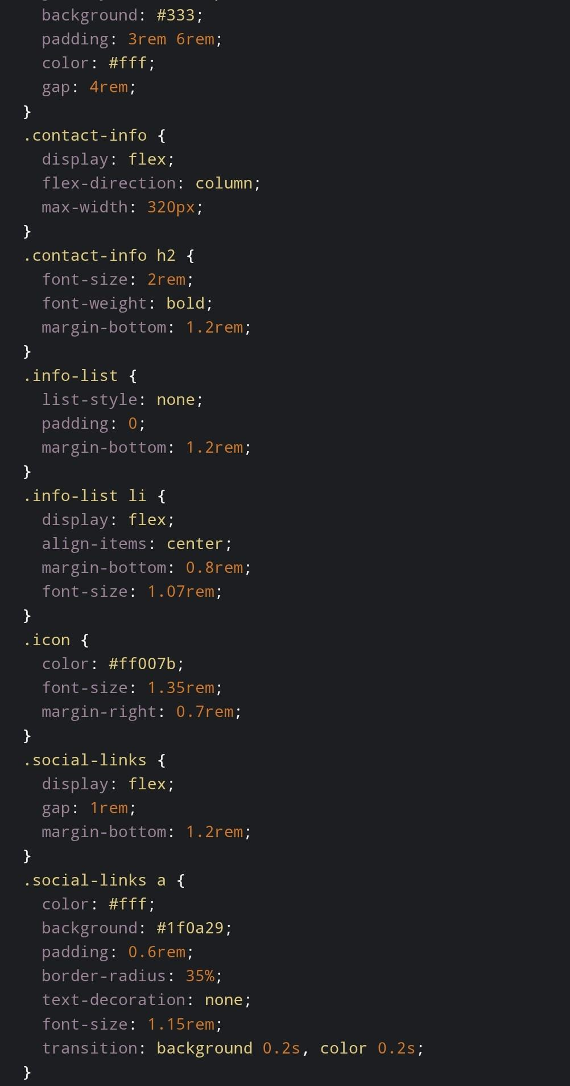
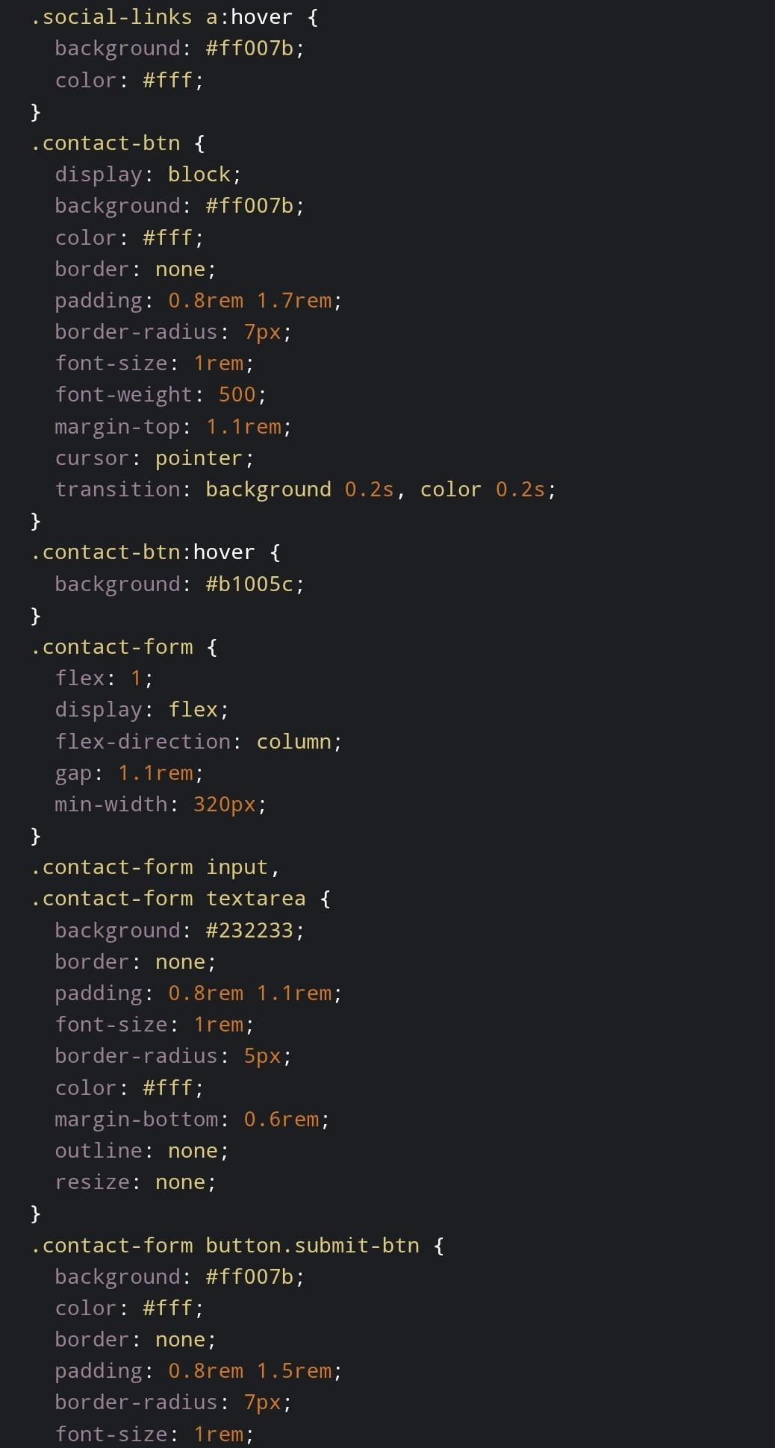
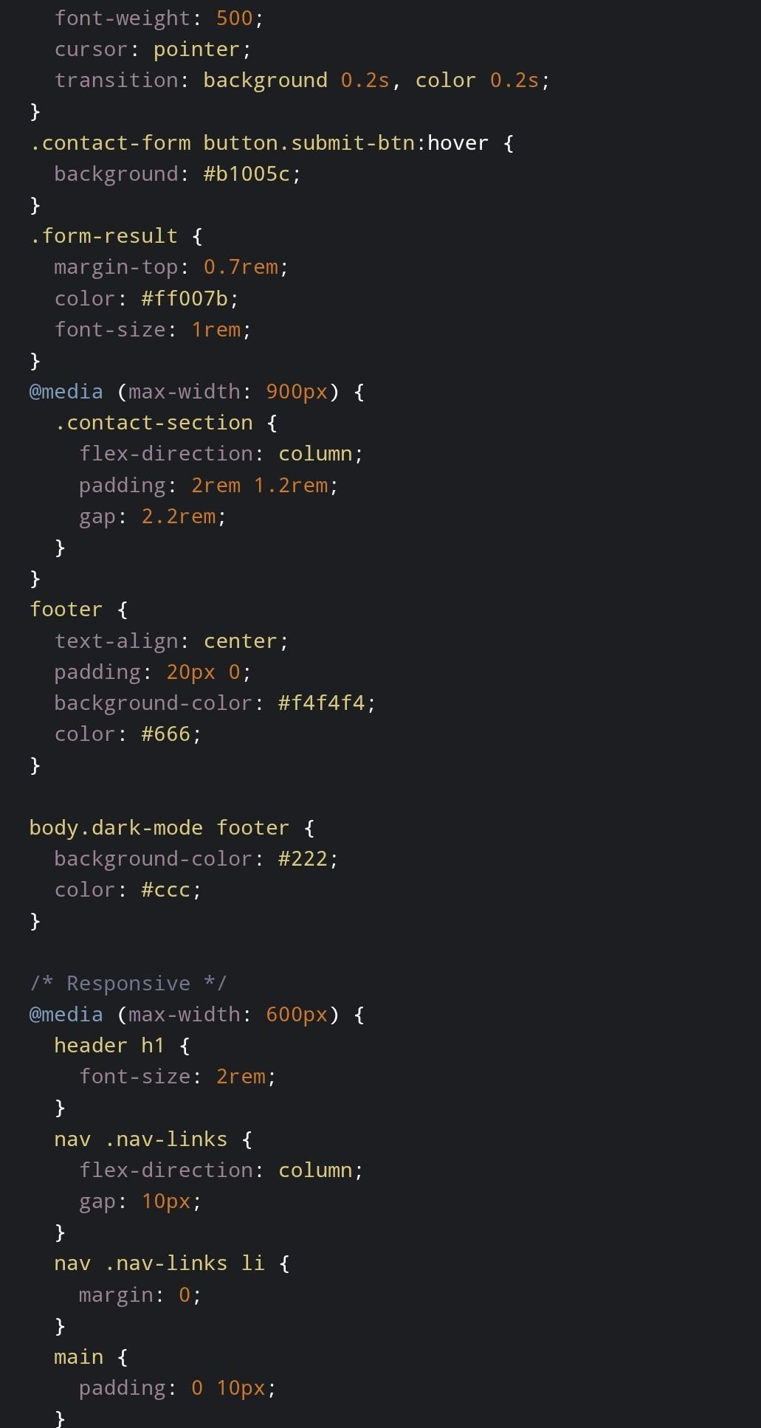

Slide 14
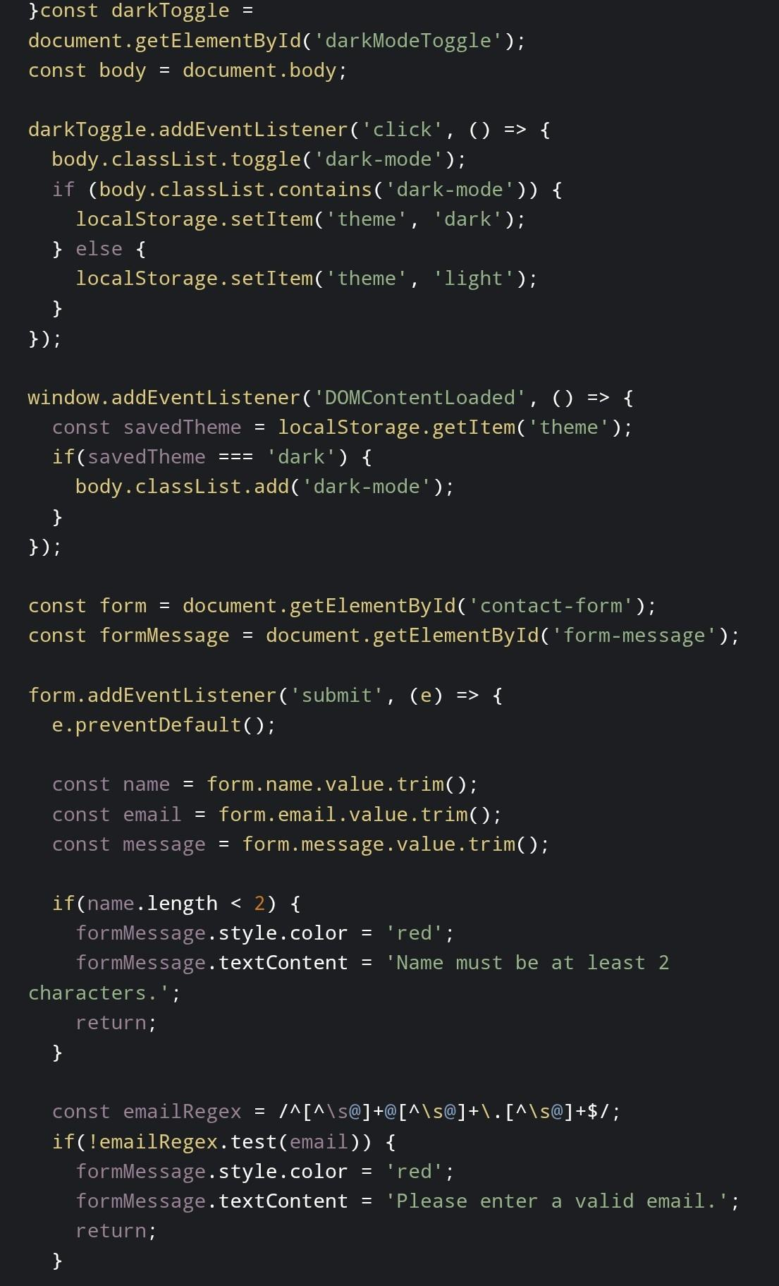
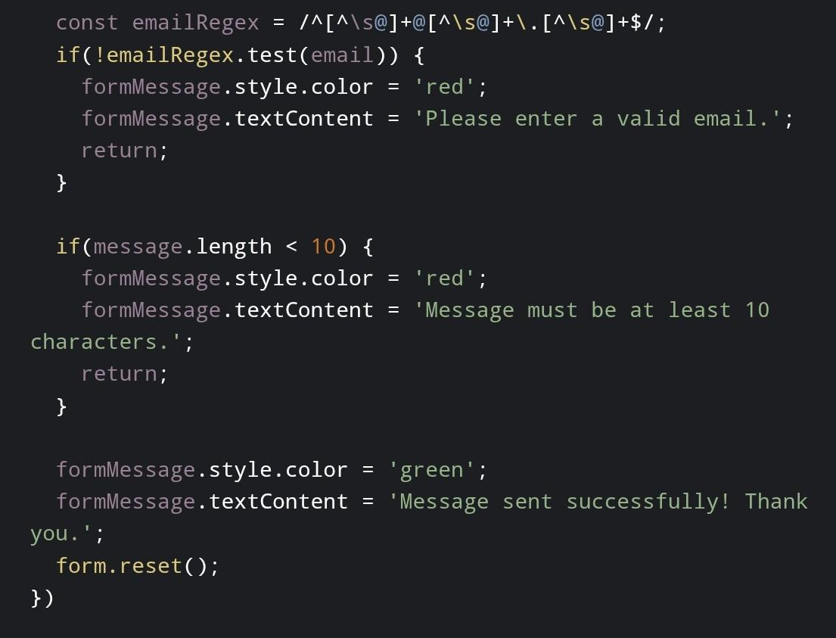

Slide 15
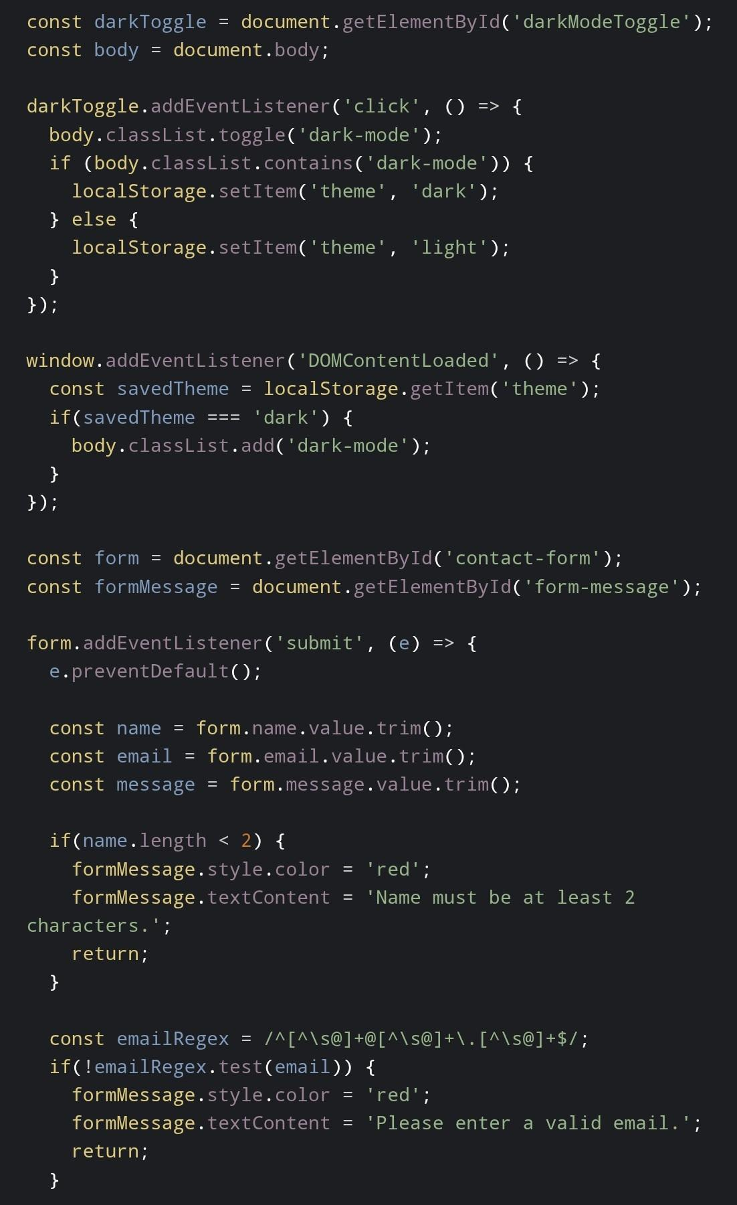
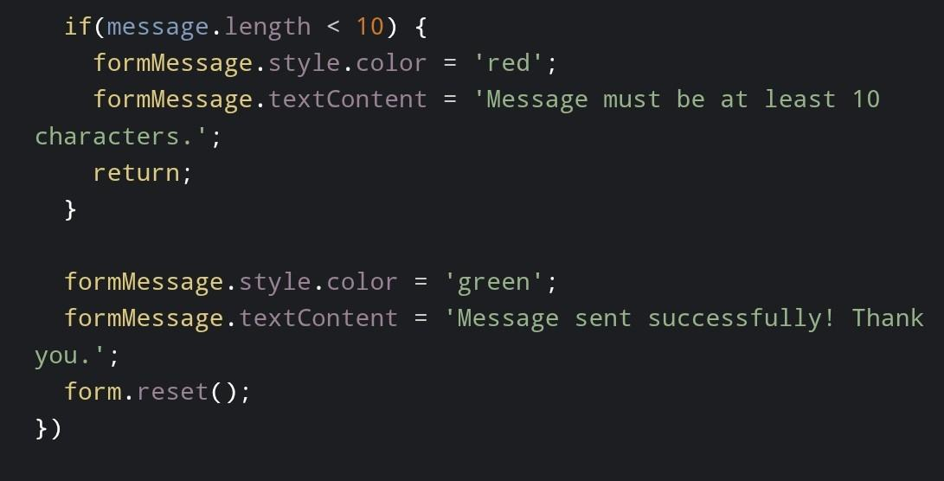
Java Script:

Slide 16

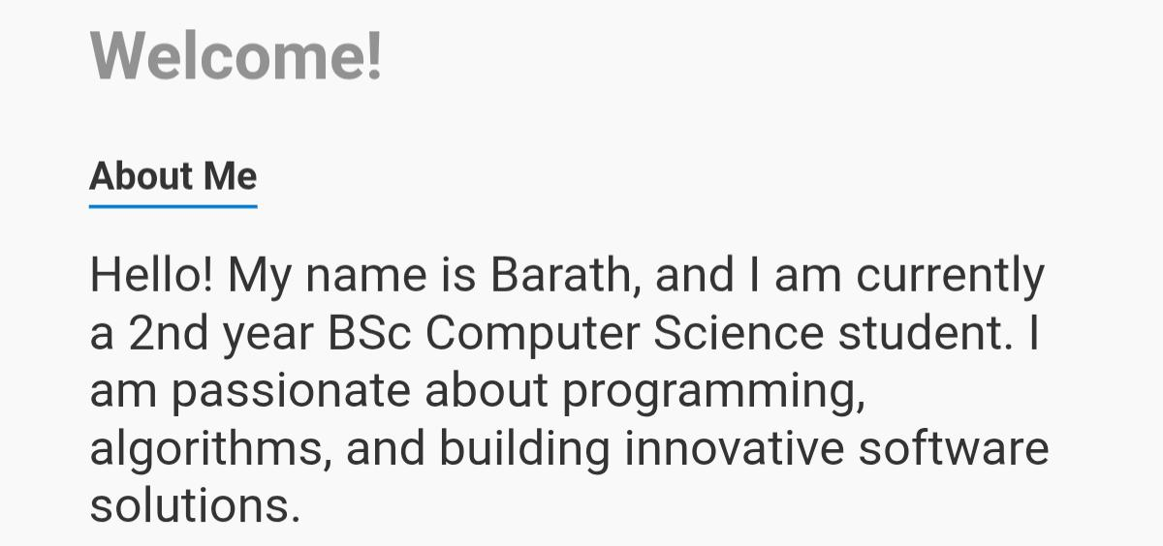
Navigation :
About Me :

Slide 17
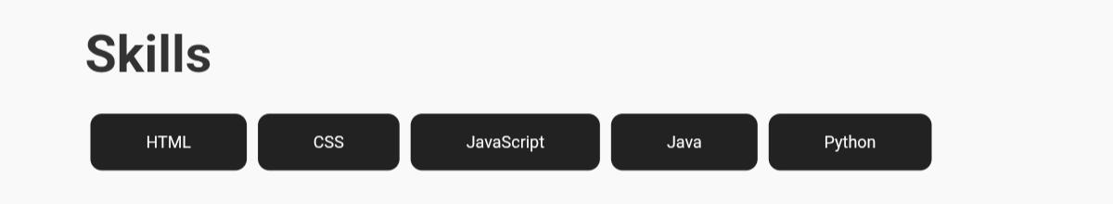
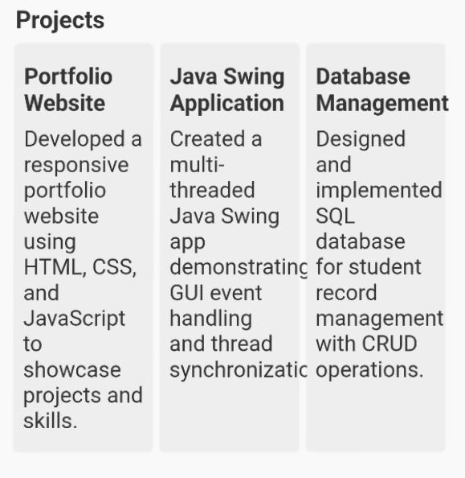
Skills :
Projects :

Slide 18
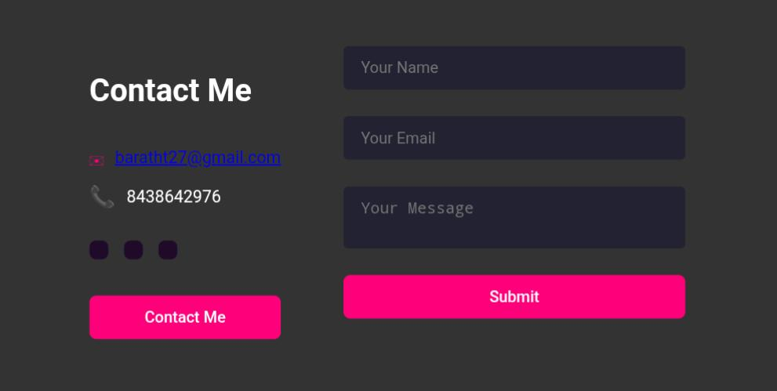

Contact Me :
Footer :

Slide 19
CONCLUSION
➤ Highlights of Your Project: Integrates both technical (coding, web development) and creative (design, wallpapers, logos) projects in a single portfolio.
➤ Features a user-friendly, visually attractive layout for easy navigation and engagement.
➤ Provides interactive elements like clickable project links and external profiles for deeper exploration.

Slide 20
Final Summary :
➤ Demonstrates a holistic approach to personal branding and self- presentation in the digital age.
➤ Offers a comprehensive record of skills, achievements, and creative growth beyond traditional resumes.
➤ Acts as a dynamic platform adaptable for academic, professional, and creative opportunities.

Slide 21
Benefits to Society:
➤ Encourages students and professionals to showcase their real skills and passion authentically.
➤ Fosters inspiration and knowledge sharing among peers, educators, and professionals.
➤ Helps bridge the gap between talent and opportunity, supporting career growth and collaboration.

Slide 22
THANK YOU ❤️

